Slide 1

MINOR PROJECT TITLE-HEART DISEASE PREDICTION USING PULSE AI
NAME: AASTHA KOTHARI
REG NO. :229311260
BRANCH: CSE(IOT&IS)
SECTION: A
SUBMITTED TO: DR.G.L. SAINI SIR

Slide 2
“Predicting Heart Disease – Because We Can’t All Be Lucky with Genetics” 💔
Welcome to my talk, where we let algorithms tell us how close we are to cardiac doom.
Human hearts: fragile, emotional, unreliable
AI hearts: logical, heartless, very reliable
Mission: Use data, dodge death (hopefully)

Slide 3
HEART DISEASE PREDICTION INTRODUCTION ❤️⏳🚑 Because waiting for chest pain is so old-school.
The heart is a crucial part of the human body, and heart diseases will remain a major issue for millions of death cases every year. World Health Organization (WHO) reports that nearly 18 million people diagnosed with heart diseases annually. Early prediction and treatment are extremely important to lower the mortality rate. This research paper includes robust machine learning and deep learning-based models for heart disease prediction. We studied and applied various ML algorithms KNN, SVM, Logistic Regression, Random Forest, XGBOOST alongside deep learning models named MLP and TAB -HRAE-LSTM, it combines Tabular Hybrid Recurrent Autoencoder for feature extraction with LSTM-based classifier. The Cleveland heart disease dataset which is part of UCI Machine Learning repository is effectively used for heart disease prediction , it has valuable contribution for building this comprehensive research and application based methodology. The ML model KNN achieved highest accuracy of 93.33% and the DL model HRAE-LSTM has outperformed and achieved 95% accuracy. This proposed research paper also includes detailed evaluation using precision, recall and F1-score.

Slide 4
DATASET USED Doctors have stethoscopes. I have Python. 🧠🔦📜
Cleveland Heart Disease Dataset🗂️
303-ish rows — not Big Data, but useful
14 features: sex, cholesterol, fasting blood sugar ,Exercise-Induced Angina, chest pain type, resting blood pressure, ST-depression, Number of Major Vessels ,Thalassemia, Slope of st-Segment , age , Resting ECG , Max Heart Rate (thalach) and target.
Binary target: disease or no disease
Class imbalance ?Of course. Balanced with SMOTE (our digital cloning tool)
KBest: Selecting top features based on statistical scoring

Slide 5
MY UNIQUE INPUTS📲
1.🧩 Multimodal Fusion: Tabular + Heart Rate Time Series
Combined clinical tabular data (age, cholesterol, etc.)
Tabular: Captures long-term risk factors
2.AI-Powered Health Recommendations – Personalized health insights based on predictions.
3. WEB App Deployment (Streamlit AND SQLITE3) – Easy-to-use interface for real-time predictions.

Slide 6
Machine Learning Models Used
🤖 Model Comparison for Accuracy & Interpretability
Logistic Regression
Support Vector Machine (SVM)
K-Nearest Neighbors (KNN)
Random Forest
XGBoost
Multilayer Perceptron (MLP)
Long Short-Term Memory (LSTM) (for sequential modeling)

Slide 7
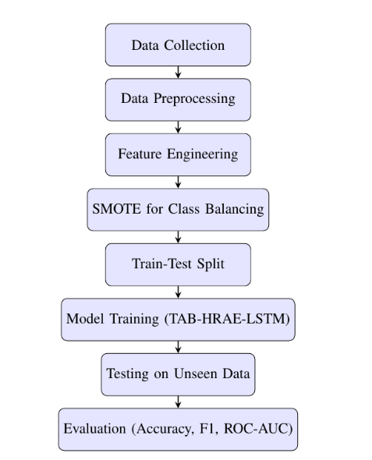
METHODOLOGY:FLOWCHART

Slide 8
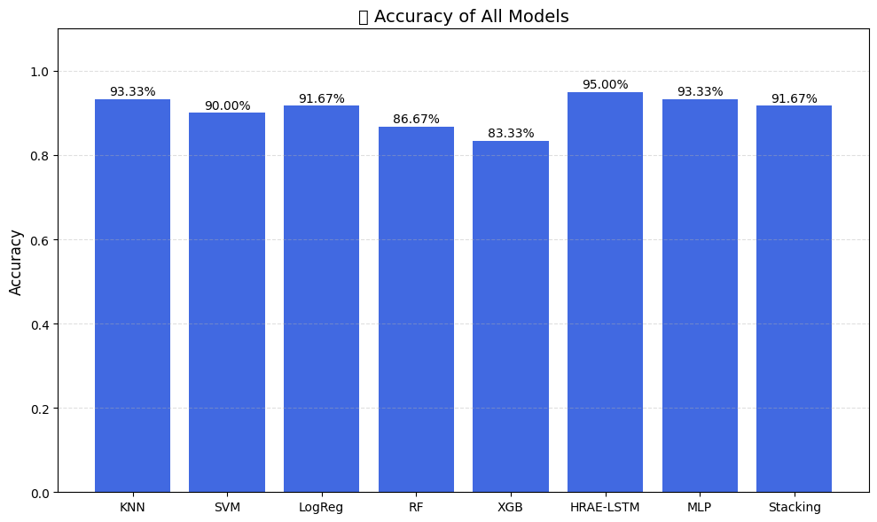
“Results – Where I Flex My Model's Muscles” 💪📈🌟
Model | Accuracy | Precision | Recall | F1-Score
KNN | 0.9333 | 0.9167 | 0.9167 | 0.9167
SVM | 0.9000 | 0.8750 | 0.8750 | 0.8750
Logistic Regression | 0.9167 | 0.9524 | 0.8333 | 0.8889
Random Forest | 0.8667 | 0.8636 | 0.7917 | 0.8261
XGBoost | 0.8333 | 0.7692 | 0.8333 | 0.8000
MLP | 0.9333 | 0.9545 | 0.8750 | 0.9130
TAB-HRAE-LSTM (PROPOSED) | 0.9500 | 0.9565 | 0.8750 | 0.9333
Stacking Ensemble | 0.9167 | 0.9524 | 0.8333 | 0.8889

Slide 9
CONCLUSION AND FUTURE WORK🎓🧘🏽‍♀️📉
We have developed a robust heart disease prediction model by combination of traditional machine learning and deep learning models and an stacking ensemble approach. Our proposed TAB-HRAE-LSTM model per formed very well and better than existing methods by achieving95%accuracyandithasalsoshownsuperior performance across all key metrics-precision, recall, F1 score. Performance Metric for all models have shown in FIG 11. This work will contribute to the growing field of AI-driven healthcare by representing that advances models can predict heart disease and can assist inpatient care.
Future Work will based on integration of real-time wearable data using APIs such as Fitbit, Google Fit and .We can implement more models to increase our accuracy such as transformer. The deployment of a web application will facilitate user interaction and dynamic feedback. Finally, continuous user input in web app will further evaluate our model. As the research in this field is increasing rapidly, integration of AI system into telemedicine areas could be more accessible across all age groups and for health professionals too.

Slide 10
DEPLOYMENT🚀🛠️😴
NOW a web app will include a trained model OVER TAB-HRAE-LSTM.
It will allow user to input 10 features and then it will predict whether the person has heart disease or not .
It will also tell percentage of getting heart disease in future also acc to patient’s data.
IT WILL TAKE PERMISSION OF USER WHETHER TO USE THEIR DATA FOR MODEL EVALUATION .
AI-BASED HEALTH RECOMMENDATION SYSTEM.

Slide 11


